Slide 1
ACT2111 Tutorial-Ch1&2
ACT2111 Teaching Team

Slide 2

Content
Where to find tutorials ?
Key Points of Chapter 1 – 2
Accounting Equation & Double-entry Accounting
Accounting Cycle – Part I: Step 1 to 4
Analyze business transaction
Journalize
Posting
Trial Balance
Other Important Concepts
Difficulties in Tutorial Questions

Slide 3
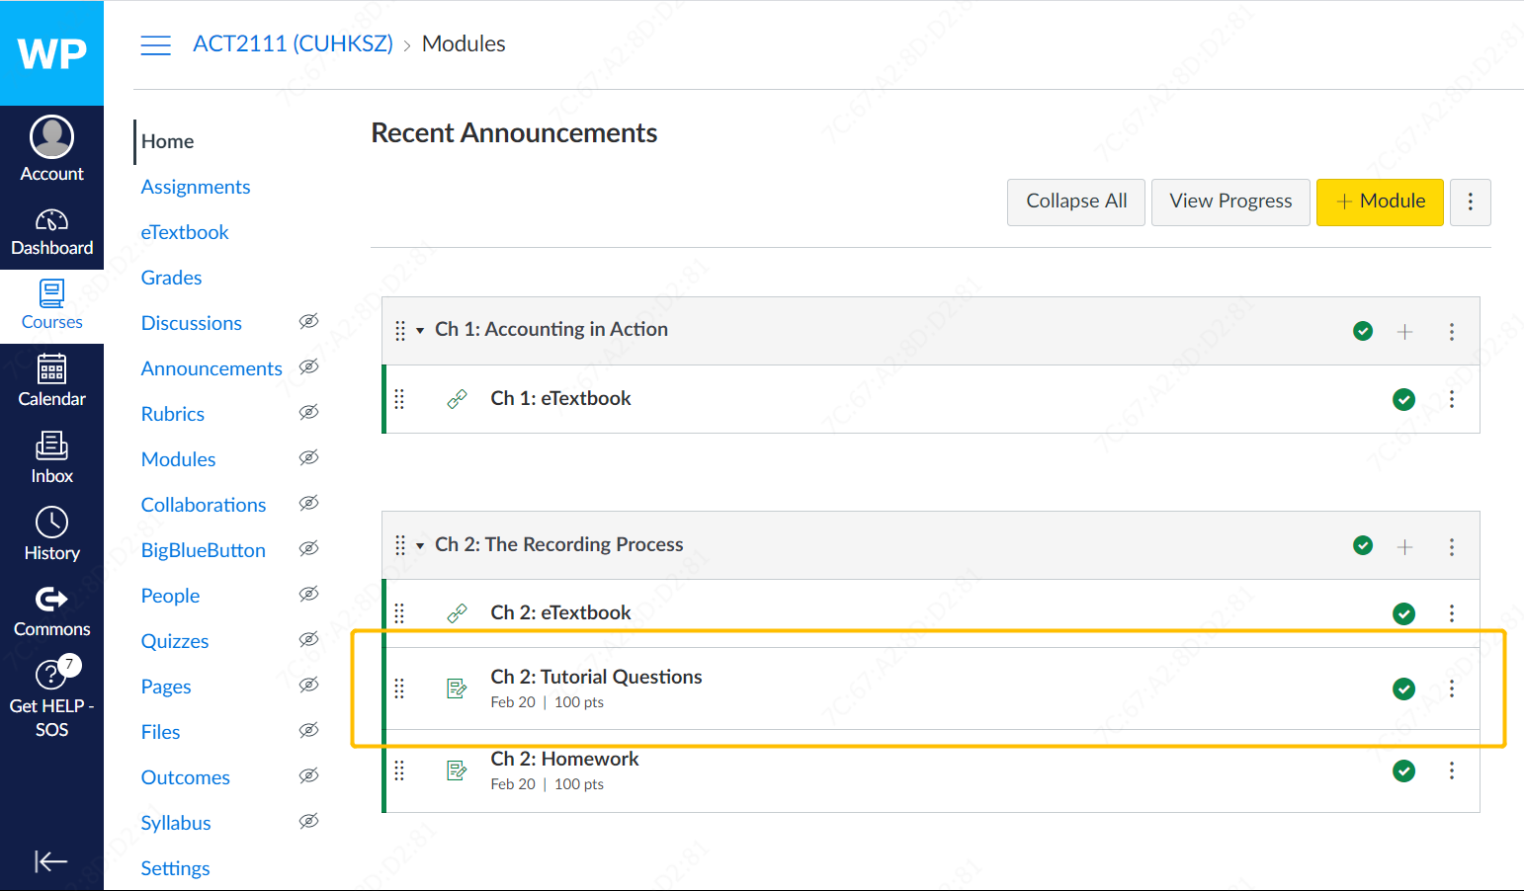
Where to find tutorials ?

Slide 4
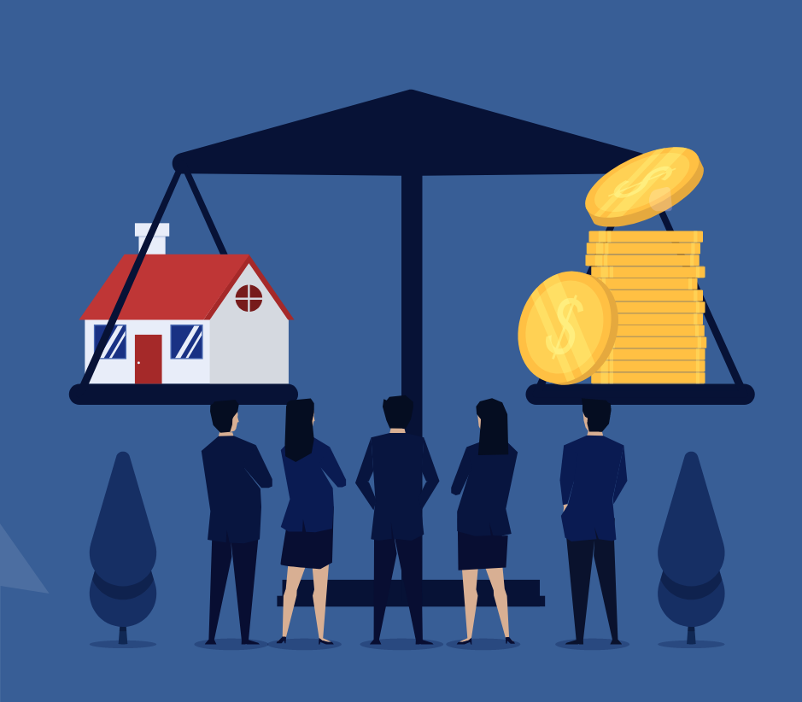
Key Points of Chapter 1 – 2
Accounting Equation & “Double-entry” Accounting
Asset = Liability + Equity
Dr / Cr
Accounting Cycle – Part I: Step 1 to 4
Analyze business transaction
Journalize
Posting
Trial Balance
Other Important Concepts

Slide 5
Accounting Equation
Three main Q&A we discussed in the 1st lecture
What is accounting ?
The "language of business“
Structuralized business information
External users: investors, creditors, customers…
Internal users: managers, employees…
Who use accounting ?
How can we use accounting to record business ?
Focus of this course
Start with Accounting Equation

Slide 6
Accounting Equation
Asset
=
Liability
+
Equity
Assets are resource a business owns
Liabilities are the creditors ’ claims on asset
Equity is the owners ’ claim on assets
Capacity to provide future services or benefits
Debts and obligation
Equity = Assets - Liability
Typical Accounts of Assets
Cash
Account Receivable
Inventory
Supplies
Equipment
…
Typical Accounts of Liability
Accounts Payable
Salary Payable
…
Typical Accounts of Equity
Share Capital - Ordinary
Revenue
Expenses
Retained Earnings
Dividends
Notes:
From ownership perspective, the equation means all the assets, every resource bring benefits in the future, that the company get should be either owned by the creditors or the owners
From

Slide 7
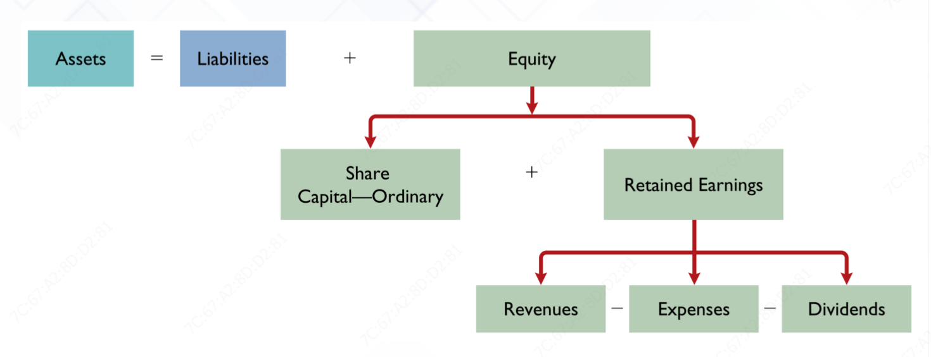
Accounting Equation

Slide 8
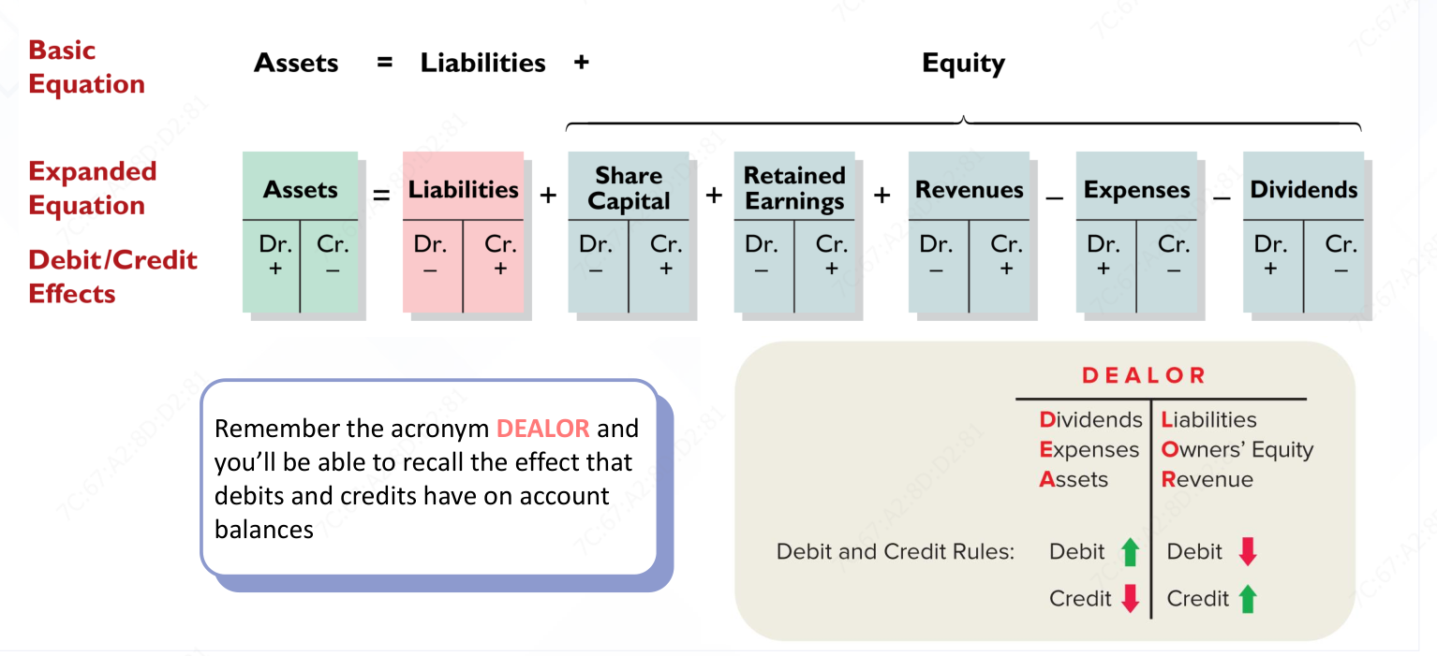
Double-entry Accounting – T-account
Credit: ACT2111 Chapter 2 P13

Slide 9
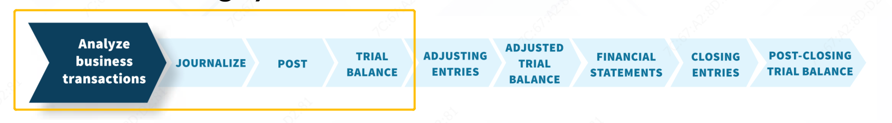
Accounting Cycle– Part I: Step 1 to 4
Accounting cycle is a process which collect and process transaction and financial data for decision making.
Chapter 1 & 2 focus on step 1 to 4
Analyze business transactions (based on accounting equation)
Journalize
Posting
Trail balance

Slide 10
Accounting Cycle – Analyze Transactions
1. Three steps in analyzing transaction (Chapter 1 PPT P31 – 44)
Whether the transaction should be record?
What accounts are involved in ?
Assets, Liability or Equity ?
Specific types of accounts ? E.g. Cash, Account Receivable or Equipment under Assets?
What amounts should be record ?
2. Some important issues
Every transaction must involve in at least two account
The equation (asset = liability + equity) should be always balanced
Types of account are not strictly limited. E.g. Assets to Assets, Liability to Equity are possible

Slide 11
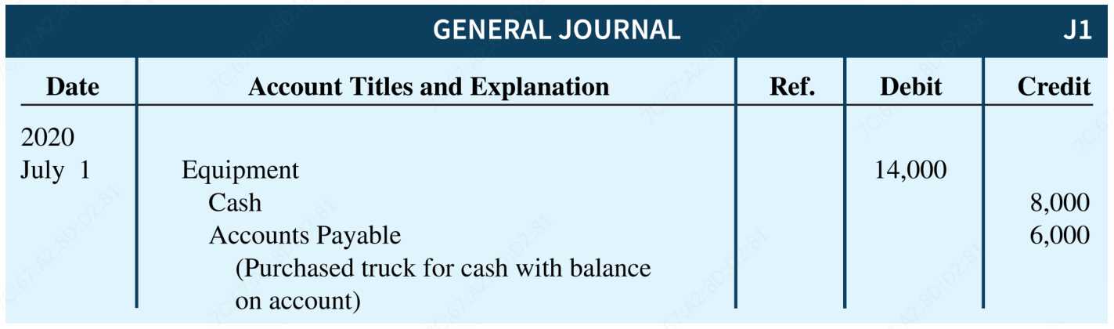
Accounting Cycle – Journalize
Journalize: Making “transaction diary” under chronological order
Follow accounting equation, total debit amount should always equal to credit amount
Three components
Date (When does the transaction recognized/happened ?)
Account titles (What accounts involved in ?)
Debit and Credit (What amounts of recording under each account ?)

Slide 12
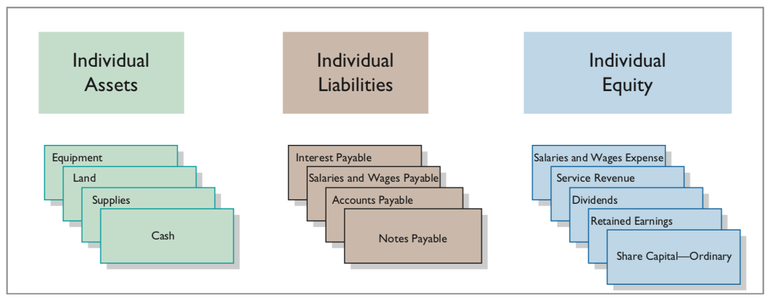
Accounting Cycle – Posting
Posting: Post the entry from Journals to the Ledgers
Change the recording from chorological order to categorical order
Ledgers: it’s like “account folders” which provide the balance in each of the accounts as well as keep track of changes in these balances

Slide 13
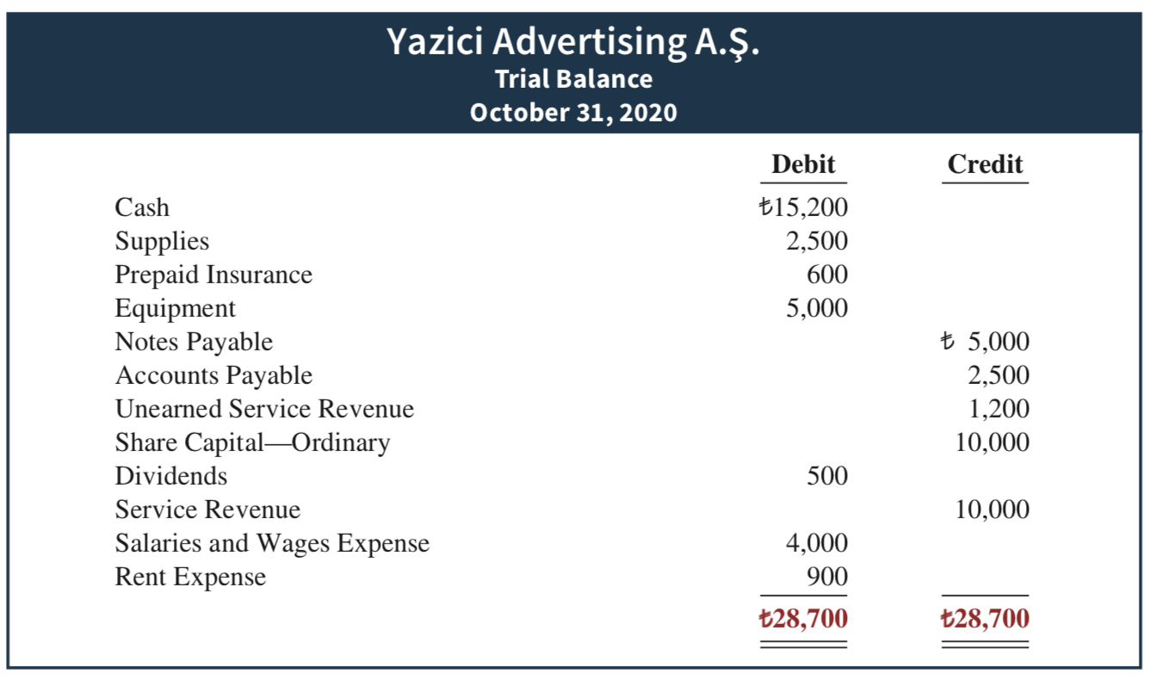
Accounting Cycle – Trail Balance
Trail Balance: Put the accounts together and test the equality and balance of the accounting equation

Slide 14
Other Important Concepts
Ethics
Financial Accounting Ethics
Standards
IFRS: International Financial Reporting Standards
Historical Cost Principle & Fair Value Principle
Relevance
Faithful representation
GAAP: Generally Accepted Accounting Principles
Assumptions
Monetary unit assumption: requires that companies include in the accounting records only transaction data that can be expressed in money terms
Economic entity assumption: requires that the activities of the entity be kept separate and distinct from the activities of its owner and all other economic entities.

Slide 15
Other Important Concepts
5 Financial Statement
Income statement: presents the revenues and expenses and resulting net income or net loss for a specific period of time.
Retained earnings statement: summarizes the changes in retained earnings for a specific period of time.
Statement of financial position: reports the assets, liabilities, and equity of a company at a specific date. (referred to as a balance sheet )
Statement of cash flows: summarizes information about the cash inflows (receipts) and outflows (payments) for a specific period of time.
Comprehensive income statement: presents other comprehensive income items that are not included in the determination of net income in 1.
(ACT2111 Chapter 2 PPT P47 – 52)

Slide 16
Difficulties in Tutorial – Chapter 1&2
Exercise 1-08
Exercise 2-17

Slide 17
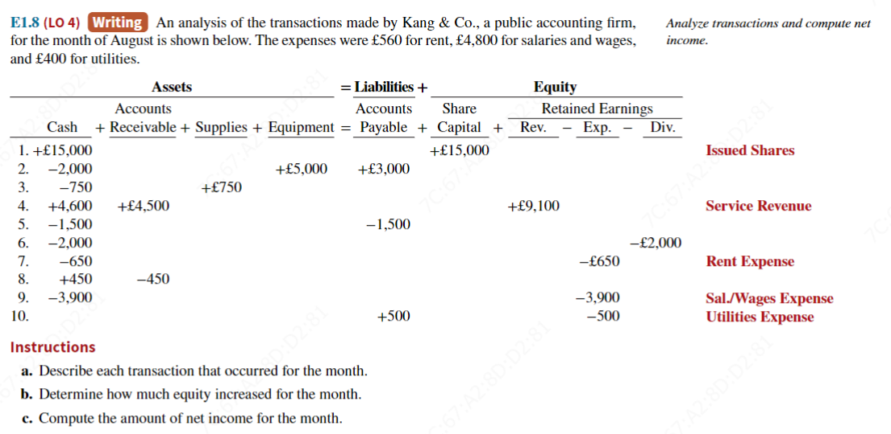
Exercise 1-08

Slide 18
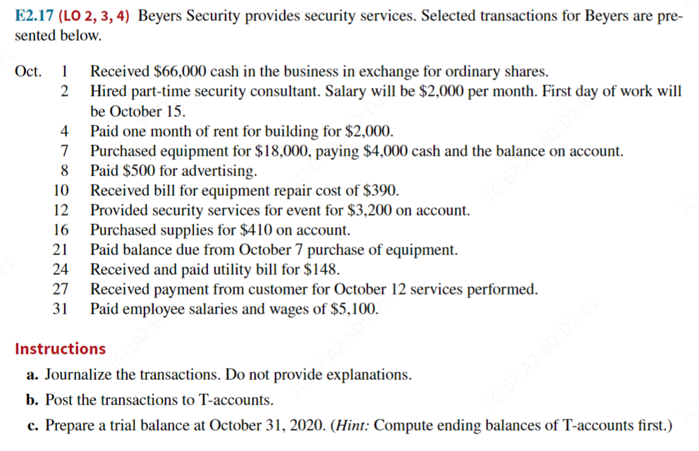
Exercise 2-17

Slide 19
Thanks for your listening !

